Slide 1
ING 112a sPRING 2022 ONLINE COURSE Week 12 UNIT 6 argumentative Essay DE-EXTINCTION STUDIES
ASLI ÖZKARA
ITU, ADVANCED ENGLISH PROGRAM

Slide 2
Steps of Writing an Argumentative Essay
Reading sources
1
Making a for & against list
2
Formulating the thesis statement
3
Making an outline
4
Writing the introductory paragraph
5
Writing the body paragraphs
6
Writing the conclusion paragraph.
7

Slide 3
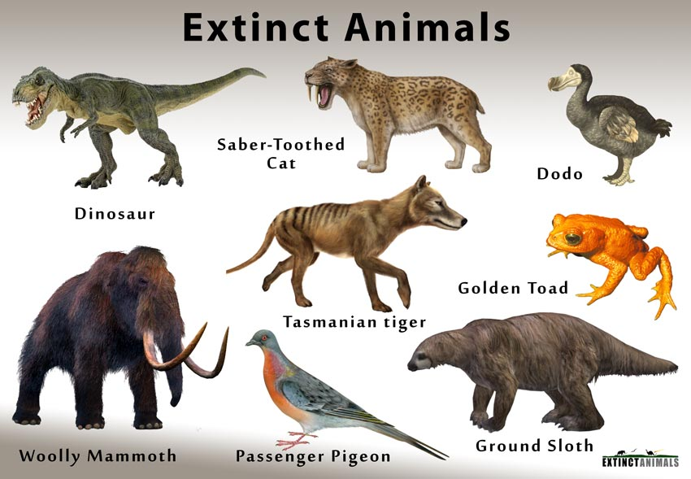
extinction & de-extınctıon

Slide 4
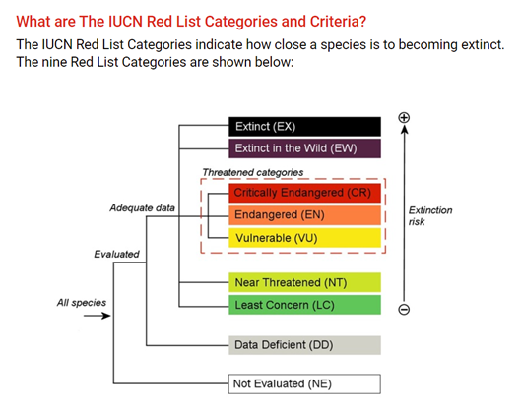
IUCN: The International Union for Conservation of Nature
The global authority on the status of the natural world and the measures needed to safeguard it

Slide 5
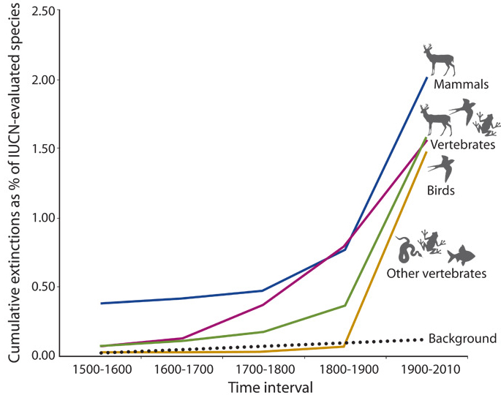
The Sixth Mass Extinction
Populations of wild animals have more than halved since 1970, while the human population has doubled.
Only five times before in our planet’s history have so many species and so much biodiversity been lost so quickly.
The fifth was when the dinosaurs were wiped out.
That is why scientists and conservationists call what is happening now the ‘sixth mass extinction’.

Slide 6
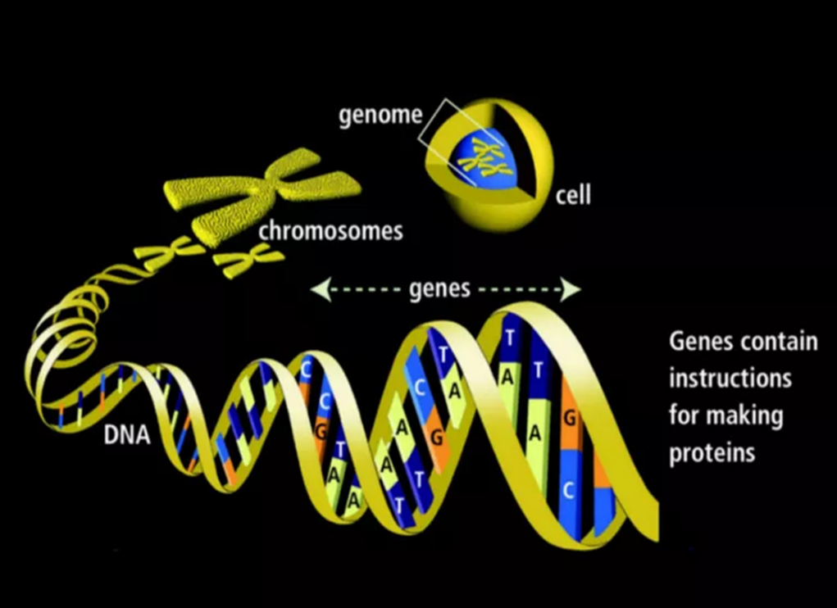
WHAT IS DE-EXTINCTION?
Also called resurrection biology.
The process of resurrecting species that have died out, or gone extinct.
De-extinction does not extend to dinosaurs, partly because of the extreme old age of specimens and the severe degradation of DNA over time.
Cloning - Somatic cell nuclear transfer (SCNT)
The first mammalian clone, Dolly the sheep (born 1996, died 2003).
Genome editing - CRISPR

Slide 7
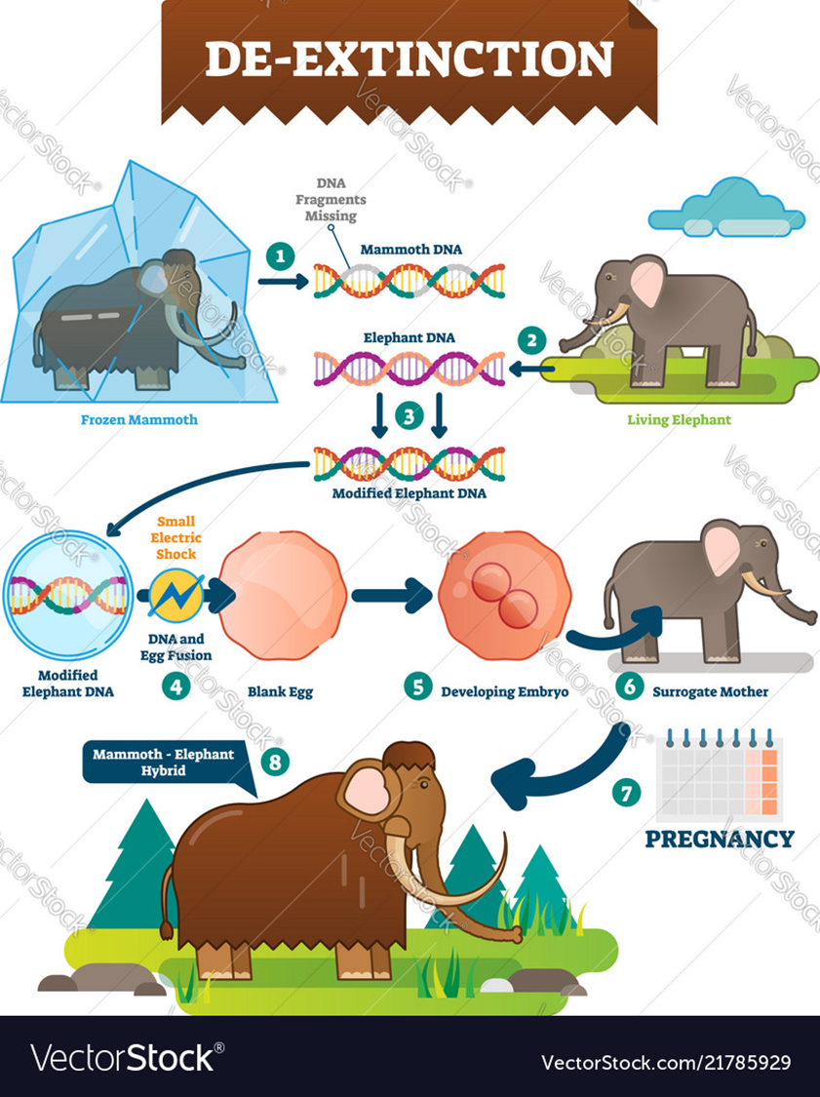
Two approaches to de-extinction
Cloning:
Extract the nucleus of an extinct animal cell
Exchange it with the nucleus of a host egg cell
Implant the egg into a surrogate
Genetically identical copy of an extinct animal will be produced.
Genetic Engineering:
Line up the genome of an extinct animal with the closest relative
Swap relevant genes from extinct animal into the living one
Implant the hybrid genome into a surrogate
An animal that looks and behaves like the extinct animal is produced.

Slide 8


Slide 9


Slide 10
De-extinction studies should be encouraged.
FOR
AGAINST
*Every species has a function in the ecosystem
-Mammoths - preserve the Arctic grasslands by spreading seeds

Slide 11


Slide 12
De-extinction studies should be encouraged.
FOR
AGAINST
*Every species has a function in the ecosystem
-Mammoths - preserve the Arctic tundra by spreading seeds
*Humans are responsible for extinction
*Extermination is playing God
*It is playing God
*Money should be spent on saving endangered species

Slide 13


Slide 14
De-extinction studies should be encouraged.
FOR
AGAINST
*Every species has a function in the ecosystem
-Mammoths - preserve the Arctic tundra by spreading seeds
*Humans are responsible for extinction
*Extermination is playing God
*It is playing God
*Money should be spent on saving endangered species
*Cloning mammoth is ethically flawed
-benefits fall behind the suffering of surrogates
-no elders to learn from or socialize

Slide 15


Slide 16
De-extinction studies should be encouraged.
FOR
AGAINST
*Every species has a function in the ecosystem
-Mammoths - preserve the Arctic tundra by spreading seeds
*Humans are responsible for extinction
*Extermination is playing God
*Ex-vivo procedure/artificial womb for mammoth revival
*It is playing God
*Money should be spent on saving endangered species
*Cloning mammoth is ethically flawed
-benefits fall behind the suffering of surrogates
-no elders to learn from or socialize

Slide 17


Slide 18
De-extinction studies should be encouraged.
FOR
AGAINST
*Every species has a function in the ecosystem
-Mammoths - preserve the Arctic tundra by spreading seeds
-Passenger pigeons - help ecological cycle in eastern America forests
*Humans are responsible for extinction
*Extermination is playing God
*Ex-vivo procedure/artificial womb for mammoth revival
*It is playing God
*Money should be spent on saving endangered species
*Cloning mammoth is ethically flawed
-benefits fall behind the suffering of surrogates
-no elders to learn from or socialize

Slide 19


Slide 20
De-extinction studies should be encouraged.
FOR
AGAINST
*Every species has a function in the ecosystem
-Mammoths - preserve the Arctic tundra by spreading seeds
-Passenger pigeons - help ecological cycle in eastern America forests
*Humans are responsible for extinction
*Extermination is playing God
*Ex-vivo procedure/artificial womb for mammoth revival
*It is playing God
*Money should be spent on saving endangered species
*Cloning mammoth is ethically flawed
-benefits fall behind the suffering of surrogates
-no elders to learn from or socialize
*Lack of genetic diversity –diseases & birth defects

Slide 21


Slide 22
De-extinction studies should be encouraged.
FOR
AGAINST
*Every species has a function in the ecosystem
-Mammoths - preserve the Arctic tundra by spreading seeds / may stop permafrost thaw & prevent methane release
-Passenger pigeons - help ecological cycle in eastern America forests
*Humans are responsible for extinction
*Extermination is playing God
*Ex-vivo procedure/artificial womb for mammoth revival
*It is playing God
*Money should be spent on saving endangered species
*Cloning mammoth is ethically flawed
-benefits fall behind the suffering of surrogates
-no elders to learn from or socialize
*Lack of genetic diversity –diseases & birth defects

Slide 23

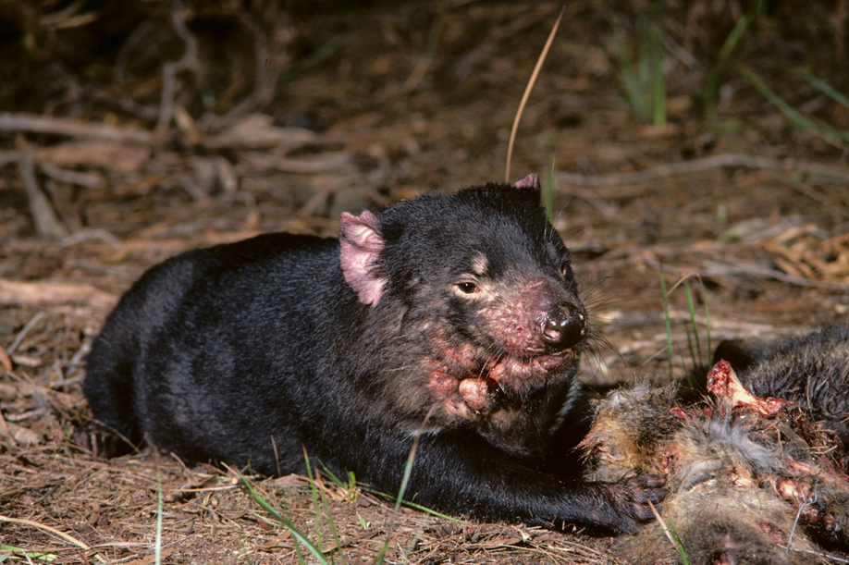

Slide 24
De-extinction studies should be encouraged.
FOR
AGAINST
*Every species has a function in the ecosystem
-Mammoths - preserve the Arctic tundra by spreading seeds / may stop permafrost thaw & prevent methane release
-Passenger pigeons - help ecological cycle in eastern America forests
*Humans are responsible for extinction
*Extermination is playing God
*Ex-vivo procedure/artificial womb for mammoth revival
*Studies might provide genetic variability to the small populations of endangered animals to cure genetic defects
- Tasmanian devils
*Studies may help prevent future extinctions
*It is playing God
*Money should be spent on saving endangered species
*Cloning mammoth is ethically flawed
-benefits fall behind the suffering of surrogates
-no elders to learn from or socialize
*Lack of genetic diversity –diseases & birth defects

Slide 25


Slide 26
De-extinction studies should be encouraged.
FOR
AGAINST
*Every species has a function in the ecosystem
-Mammoths - preserve the Arctic tundra by spreading seeds / may stop permafrost thaw & prevent methane release
-Passenger pigeons - help ecological cycle in eastern America forests
*Humans are responsible for extinction
*Extermination is playing God
*Ex-vivo procedure/artificial womb for mammoth revival
*Studies might provide genetic variability to the small populations of endangered animals to cure genetic defects
- Tasmanian devils
*Studies may help prevent future extinctions
*It is playing God
*Money should be spent on saving endangered species
-cut in funds for conservation programs
*Cloning mammoth is ethically flawed
-benefits fall behind the suffering of surrogates
-no elders to learn from or socialize
*Lack of genetic diversity –diseases & birth defects
*We need large populations to help ecosystem & to continue breeding
-Few mammoths/pigeons won’t help
*Populations are dying so save them to benefit the ecosystem

Slide 27
Sample Essay: DE-EXTINCTION- MORE THAN A FANTASY
Bringing back dinosaurs, which went extinct about 65 million years ago, might be a fantasy that will remain in the film Jurassic Park, but the scientific research has advanced so far that in a near future it will be possible to see extinct animals back in life again. De-extinction studies are in simple terms the scientific research carried out to revive the extinct species by genetic engineering and biotechnological processes. The main motive behind these studies is the accelerating numbers of species being on the verge of becoming extinct and gaining back the lost benefits that extinct animals contributed to the ecology. According to the latest report of the International Union for the Conservation of Nature (IUCN), the global authority to catalogue species, in 1998 the number of critically endangered species was 1820, but in 2021 this number jumped to 8188. The total conservative number of extinct and possibly extinct species so far is 65, and the total number of the ones only under conservation but extinct in the wild is 134 (2021). Therefore, due to the rapid rise in extinction rates, de-extinction studies have gained momentum in recent years. It is undeniable that de-extinction studies have brought heightened excitement to the scientific world, but they also caused a major dispute among many ecologists and researchers. While it is argued that studies related to the revival of extinct species might bring some problems, de-extinction studies should be progressed further because the scientific advances will help conserve the endangered ones, the revived species will be beneficial for the ecosystem, and the moral obligation of humanity will be fulfilled.

Slide 28
The first argument about de-extinction is centered on the conservation efforts for endangered species. Some conservationists maintain that focusing on de-extinction programs and allocating money to reviving a few species will hamper the conservation efforts. They claim that the budgets are already tight, so there might be a cut in conservation funds but if the money is spent on species on the brink of extinction instead of the extinct ones, they will have a hope to save them from dying out. However, all scientific studies and advancements on de-extinction will not only resurrect the extinct species but also will benefit the endangered ones. As the human population is growing and wild spaces for many species are shrinking rapidly, new and creative solutions should be found to prevent the extinction of many more species. By examining the genomes of extinct species, scientists can understand the reasons behind their extinction, so their close relatives can be protected from these vulnerabilities. Additionally, the endangered species have tiny populations so their genetic variability reduces, causing them to be vulnerable to diseases and climate change. By applying de-extinction techniques, the genetic defects of endangered ones can be restored. Brand gives the example of endangered Tasmanian devils, which have a transmissible cancer problem. If the gene responsible for cancer can be cured by cloning, the immune animals will not transmit it so cancer will soon disappear resulting in an increase in the Tasmanian devil population (2013). In brief, advances in de-extinction research will also aid those species threatened with a complete loss.
I. Conservation of endangered species
A. Hamper the conservation efforts
1. there will be cut in funds
2. Money better spent on the endangered ones
B. Benefits for the endangered species
1. New creative solutions
2. Genomic examination of the extinct
3. Restoring genetic defects
a. Tasmanian devils (Brand, 2013)

Slide 29
Another commonly argued issue is the sustainability of the ecosystem. Opponents of the de-extinction efforts claim that bringing back only a few animals of a certain species will not help the ecosystem because there must be a big population to create a positive difference. The further contention is the difficulties of creating a big population due to the lack of genetic variability necessary for healthy generations and a healthy natural ecological cycle. However, de-extinction studies can indeed help maintain the ecosystem. Some extinct species were vital for their ecosystems. Following their extinction, there were major negative outcomes, which can be reversed by de-extinction. For example, Siberia was grassy steppes when mammoths lived there, but now it is only mossy tundra so bringing back mammoths will have vital benefits. To illustrate, the landscape will change with the revival of the mammoths. When mammoths spread seeds with their manure, knock down the trees, and break the soil with their heavy steps the ecosystem will be restored. Another example is the passenger pigeons, which went extinct at the start of the twentieth century. Novak states that these pigeons were vital for their habitat in eastern North American forests by regenerating the forest, hence leading to the survival of many other plants and animal species. It is possible to create large flocks of resurrected passenger pigeons because there is enough scientific knowledge, genetic material, and close living relatives to be surrogates (2016). Moreover, advances in genetic engineering will solve the problem of genetic variability. A new approach is used in mammoths and passenger pigeons in which the genomes of an extinct animal and a close relative are lined up and the hybrid genome is implanted by using gene-editing tools. Therefore, genetically identical copies are not born, but new engineered animals will be produced. Shortly, the ecosystem can be restored and maintained by applying the techniques developed in de-extinction research.
II. Sustainability of the ecosystem
A. No help on ecosystem
1. Necessity for large populations
2. No genetic variability
B. Beneficial for the ecosystem
1. Vital extinct species for the ecosystem
2. Reversal of negative outcomes
a. Siberian steppes & mammoths
b. North American forests & passenger pigeons (Novak, 2016)
3. Genetic variability with new techniques
a. Lining up genomes

Slide 30
The final argument put forth against de-extinction practices is the ethical concerns. The opponents mainly center their moral arguments on the violation of animal rights. They claim that all these efforts are only to please the curiosity of the public rather than the welfare of the world. They argue that both the resurrected and surrogate animals will suffer from genetic adjustments. Another moral concern of the opponents is that de-extinction means ‘playing God’. In fact, studying de-extinction is an ethical obligation for the future of the world. Although there is a curiosity in the center of all these efforts, it is not an idle interest but an eager wish to help conserve the life forms on the planet. Scientists working on de-extinction programs are more concerned with the welfare of animals than many other people. Harvard professor Church who leads the mammoth de-extinction program has been working on alternative ways such as an artificial womb to eliminate the suffering of a surrogate Asian elephant. Devlin (2017) quotes Church saying “We hope to do the entire procedure ex-vivo (outside a living body). It would be unreasonable to put female reproduction at risk in an endangered species.” Moreover, de-extinction is not ‘playing God’ as some claim, but it is an opportunity to reverse the wrongs of humanity who played God while wiping them out of the Earth. Many species went extinct because of illegal hunting, the pollution humans created, or the loss of their habitat because of human populations. Therefore, it is something people owe to the species which became extinct because of human activities rather than natural causes.
III. Ethical issues
A. Violation of animal rights
1. Curiosity rather than benefit
2. Surrogate animals suffer
3. De-extinction is ‘Playing God’
B. An ethical obligation
1. Causing extinction is ‘Playing God’
2. Animal welfare
a. Ex-vivo (Devlin, 2017)
3. Human activities made them extinct
a. Hunting, pollution, loss of habitat

Slide 31
To conclude, studies related to de-extinction should be carried out extensively since they are a modern tool to preserve the endangered species as well as the ecosystem. Also, the studies are the remedies of humans to turn back the time and correct their mistakes. Therefore, more research should be conducted to get rapid and flawless results. Only through this way, the next generations can enjoy a healthy and vivid planet.

